Slide 1
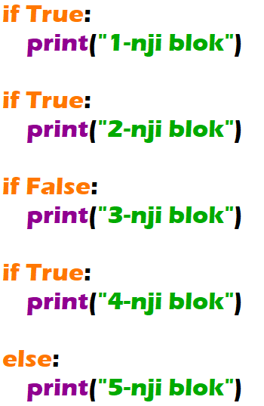
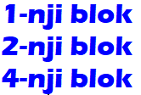

Slide 2
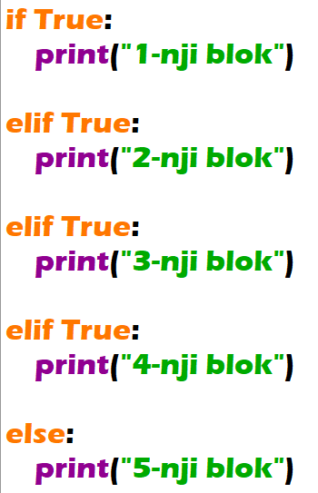


Slide 3
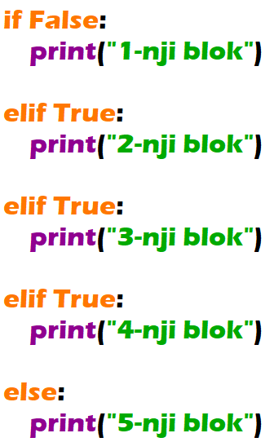


Slide 4
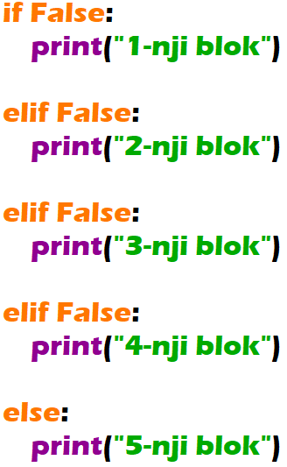


Slide 5

Get the exam grades from user. If the exam grade is between 100-85 output “5”, if the exam grade is between 84-70 output “4”, if the exam grade is between 69-50 output “3”, if it less than 50 then output “2”.
Grade | Mark
100-85 | 5
84-70 | 4
69-50 | 3
49-0 | 2

Slide 6
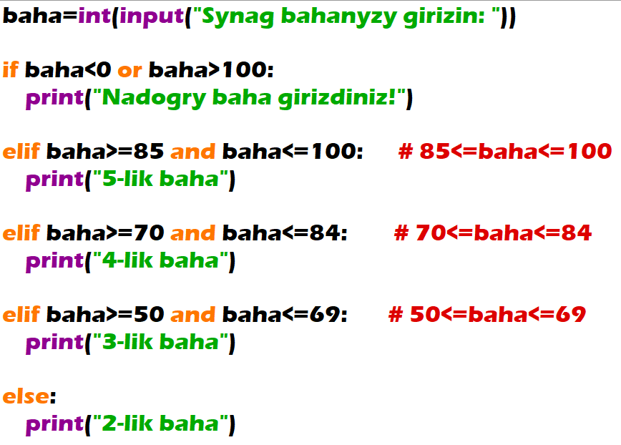


Slide 7
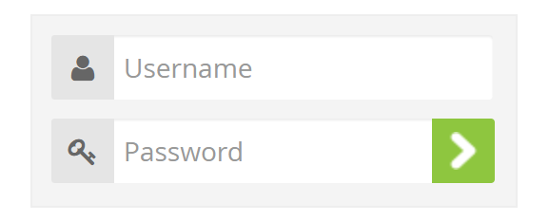
The user in order to enter to system should know his username and password. If the user enters correct username and password the program outputs “You have entered into the system”, if the user enters right username and wrong password the program outputs “You have entered wrong password”, if the user enters wrong username and right password the program outputs “You have entered wrong username”.

Slide 8
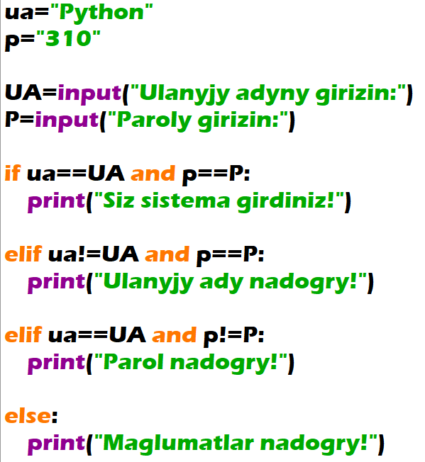
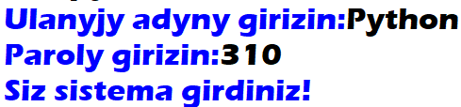

Slide 9
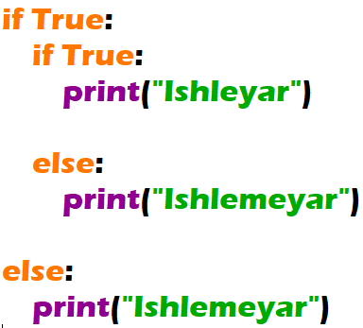
Nested if

Slide 10
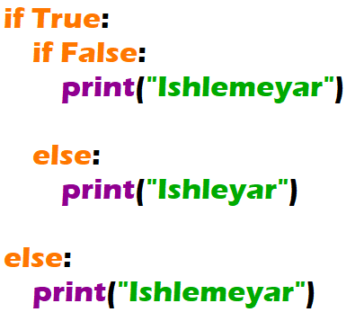
Nested if

Slide 11
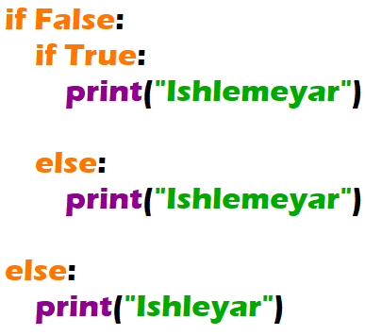
Nested if

